Slide 1

Metandao Holding Limited.CO
https://metandao.com/

Slide 2
ABOUT US
Metandao is a game company founded in Hong Kong in 2021, integrating R&D, publishing and operation. The members are mainly from Singapore and Hong Kong. They are talents in various fields of the game industry, with seasoned experience and full of confidence in the future of the blockchain. At the same time, We also have senior blockchain experts in our team as our advisors.
The predecessor of Metandao is a team from SeaSun with more than 10 years of mobile game R&D experience, which has developed card RPG, survival RPG (Survival), casual game (Casual), simulation construction game (Sim) and other games.
We are determined to be the Nintendo of the blockchain game industry. We are a team dedicated to combining game development technology, blockchain technology and Metaverse to create a new generation of gamefi. We believe that the future belongs to the era of High-quality Blockchain games. Taking the advantages of traditional game development, we firmly believe that we will create a High-quality Blockchain game that is in line with the times and will become a phenomenonal game.

Slide 3



We Are Focus On
Blockchain Game Development
In the future, we will continue to develop games based on NFT and blockchain technology, combining our nearly 10 years of experience in developing games. In the future, we plan to focus on RPG, Survival, Casual, and Sim construction games.
Blockchain Game Pubishing
- We have many years of experience in game publishing and operation.
- 3 years of cryptocurrency issuance experience.
- In addition to operating and publishing our own games in the future, we will also actively cooperate with third-party game development products, focusing on blockchain packaging and distribution.
Game Public Blockchain(In the Future)
In the future, we will launch our own game chain, provide low latency, low cost, high concurrency, and launch our own SDK to reduce development costs in game development.

Slide 4
CORE TEAM MEMBERS
Howard Zeng CEO/Founder
More than 10 years of experience in game R&D project management. Started to develop mobile games and publish games worldwide in 2008. Used to worked in SeaSun Entertainment(Kingsoft).
David Tang COO
3 years of sole role experience in Crypto industry. Have good relationship with many major market markers, crypto VC/Funds and compliance/legal.
Leo Huang Leader Artist
Worked in SeaSun Entertainment since 2011. With more than 10 years of experience in 2D/3D game art design. Participated in the game development of JX3.
Reeves Zhong Leader Programmer
More than 10 years of server R&D experience, worked for Tencent and SeaSun Entertainment(Kingsoft) successively. Participated in the project of Solitaire Trip, Brave Cross and Days of Decay.
Xavi Su Client Programmer
7 years of experience in game client development. Used to work in SeaSun Entertainment(Kingsoft). Participated in the project of Story of Cloud Town, Brave Cross, and Days of Decay.
Wade Su Head of Game Design
9 years of rich game design experience, worked in SeaSun Entertainment(Kingsoft). Participated in the game design of Seal of Demon, Brave Cross and Days of Decay.

Slide 5
OUR ADVANTAGE
Our core members have successively worked in well-known game development companies.They are all talents in various fields of the game industry, and together they form an experienced and complete team.
Game development: We have our own set of client-side and server-side frameworks. After the project is established, the game can be rapidly developed based on this framework
Game design: The game design team is very experienced in card type and survival type games, and has mature accumulation of game system, growth and numerical system, and has been verified through commercialization.
Game art design: The art design team is responsible for the overall art design. The team is relatively complete and has rich experience. Including technical art, character original painting, scene original painting, 3D scene, action, special effects.
Game publishing: The creators are very experienced in game publishing, and have released several world-class mobile game works, which have achieved great commercial success.
Blockchain: There are resident blockchain experts in the team, who are very experienced in crypto currency issuance, and have also designed a complete and balanced game economic system.

Slide 6
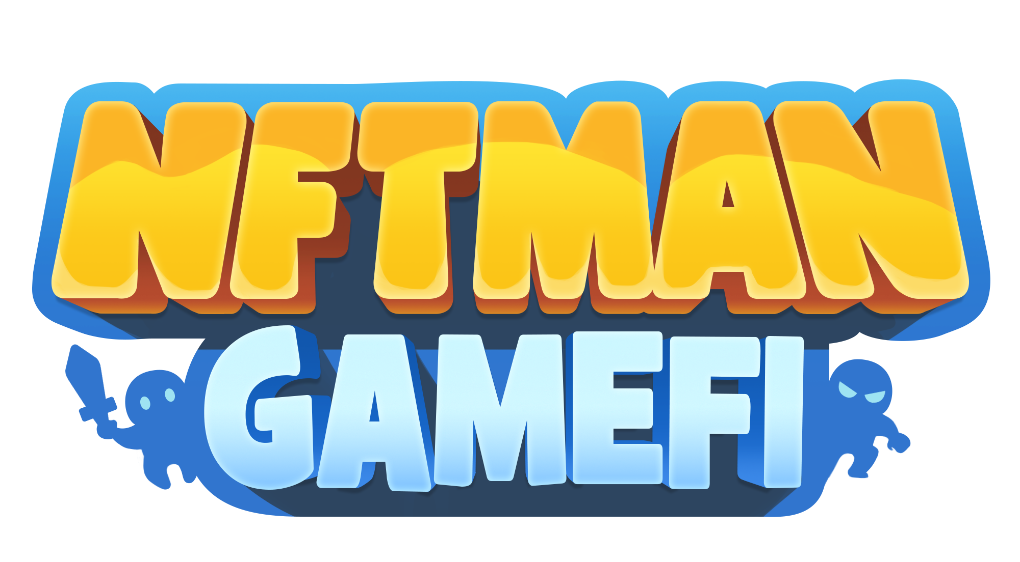
OUR FIRST NFT GAME
PRODUCT NAME: NFTMan
NFTMan is a decentralized card turn-based RPG Blockchain game based on Binance Smart Chain.
TYPE: ACTION CARD TURN-BASED
Scope of sale: Global
We are committed to combining traditional game development with blockchain technology to create a world-scale high-quality blockchain game in the new era. We combine a perfect game system with a balanced economic system to maximize the playability and viewing experience, so that players can enjoy the game and earn money while playing. NFTMan is our first Action card RPG Play to Earn game.

Slide 7
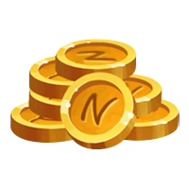
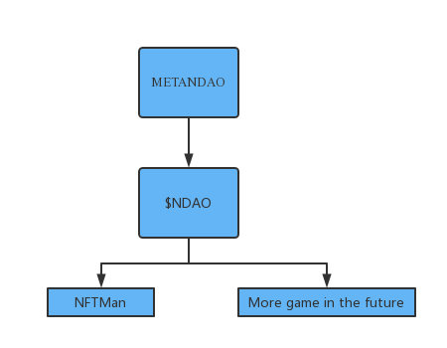
RALATION BETWEEN OUR PRODUCT & TOKEN
$NDAO will be the Token throughout our entire Metaverse.
$NDAO, as the main currency, will be circulated in all the games we develop. We hope to make $NDAO a long-term game token, and increase the value and statement cycle of $NDAO by issuing more games, and are committed to making $NDAO a long-term stable currency.

Slide 8
TOKENOMICS ALLOCATION

Slide 9


FINANCIAL PLAN
Valuation: 15 milion $USD
Offer to Sale: 3 milion $USD (20%)
The funds will be used for:
-Blockchain Game development
-Team Building
-Develop epoch-making high-quality blockchain games

Slide 10
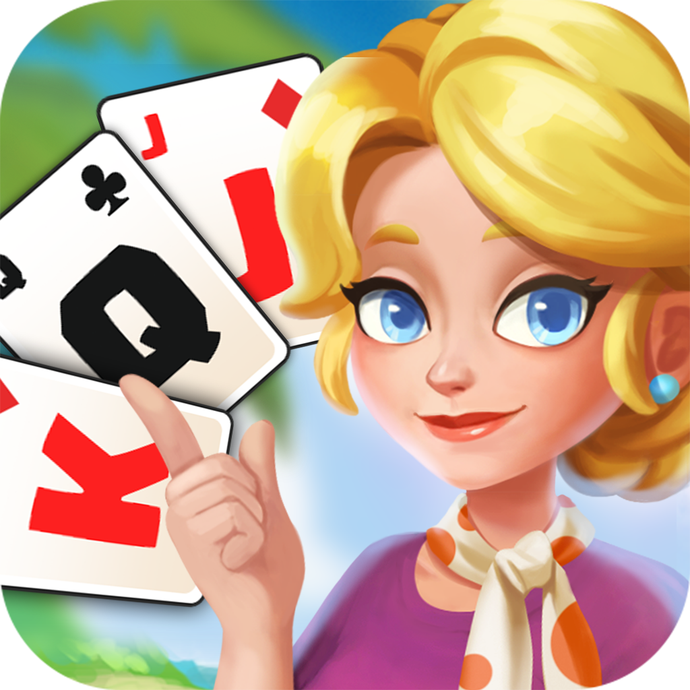
DISPLAY OF PRODUCT
PRODUCT NAME: Solitaire Trip
Game type: Solitaire Casual Game
Scope of sale: Global
Platform: Android/IOS

Slide 11
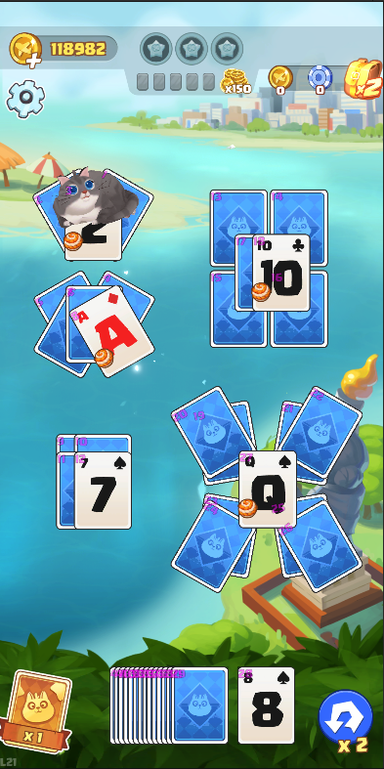
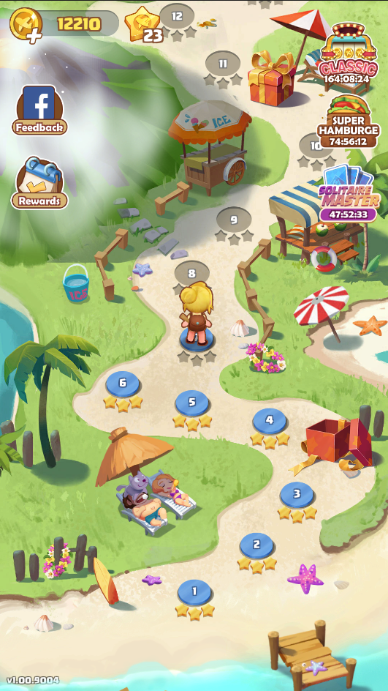
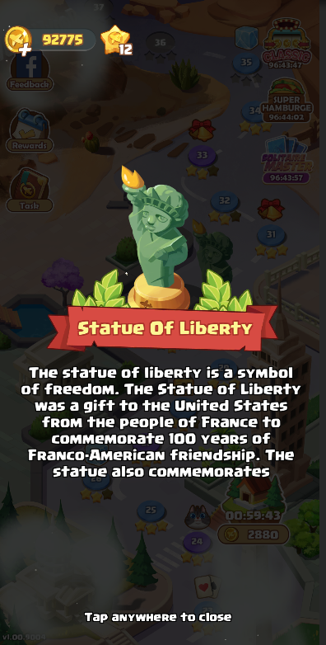
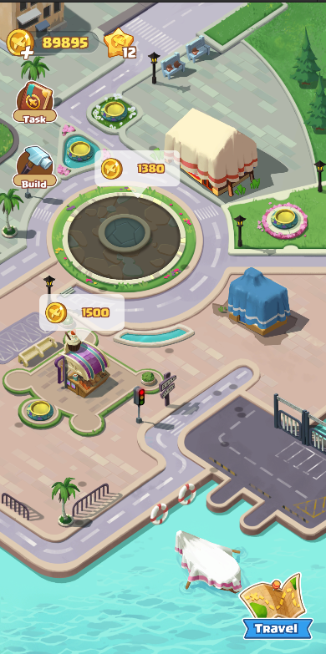
PRODUCT DESCRIPTION
A classic solitaire game for any age. Each level has different rules and props. Players can also collect souvenirs and travel stamps from various countries.

Slide 12
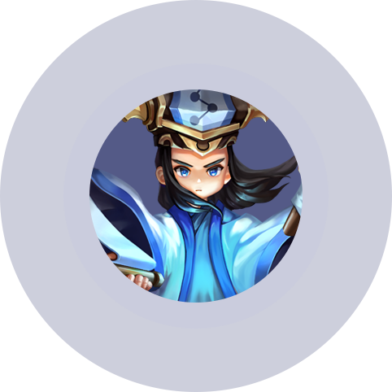
PRODUCT NAME: Brave Cross
Game type: Action Card Game
Scope of sale: Global
Platform: Android/IOS

Slide 13
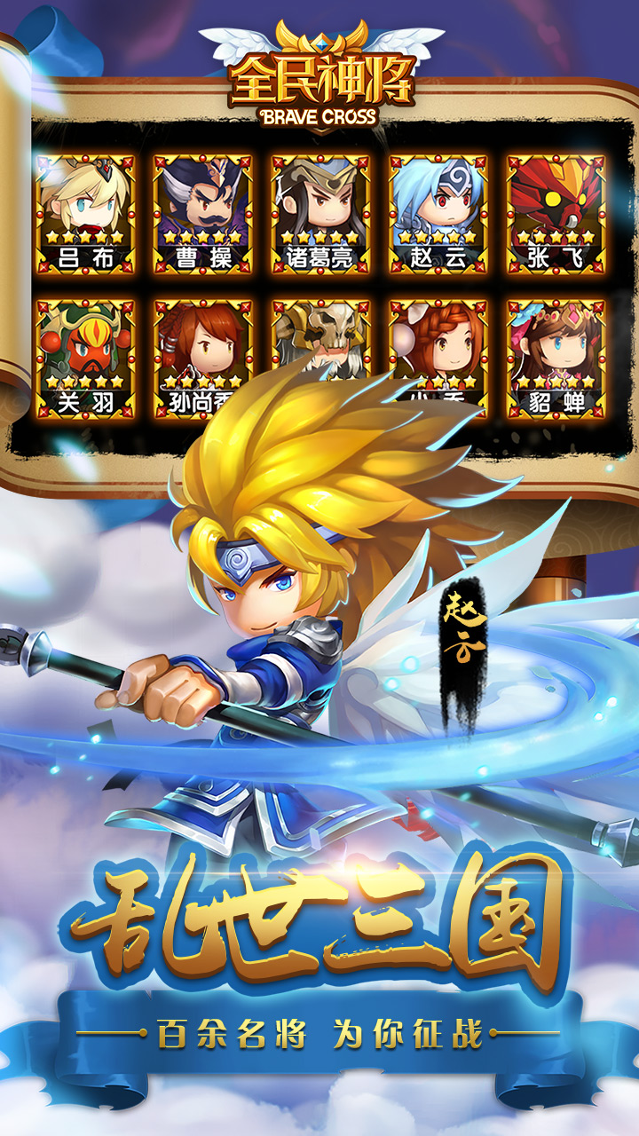
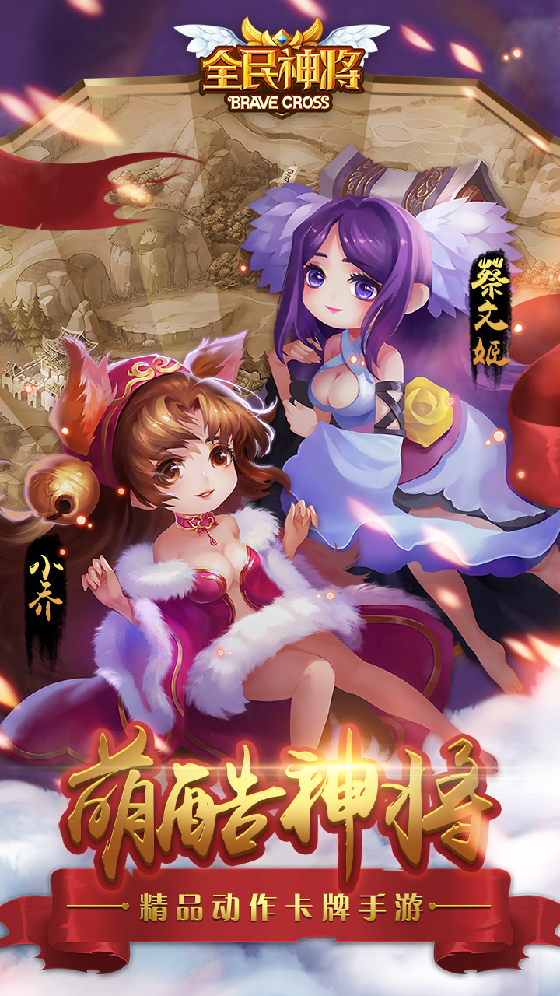
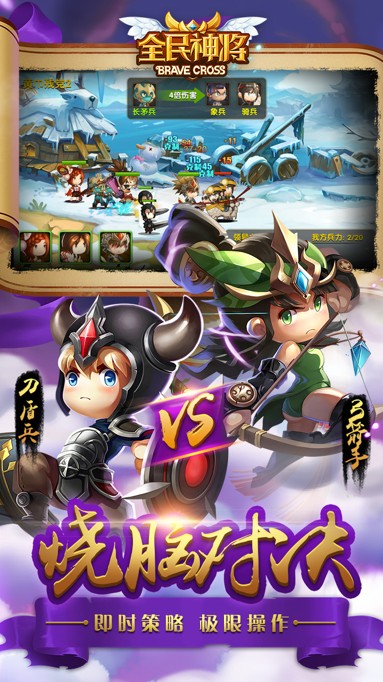
PRODUCT DESCRIPTION
A masterpiece of the Three Kingdoms-themed action card mobile game, perfectly integrated into the development of generals, the battle for famous cities, and the real-time formation of troops and other exciting gameplay!

Slide 14
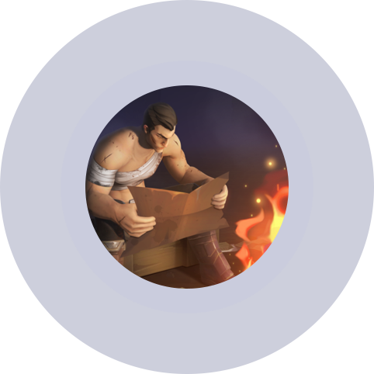
PRODUCT NAME: Days of Decay
Game type: Doomsday Survival Sandbox Game
Scope of sale: Global
Platform: Android/IOS

Slide 15
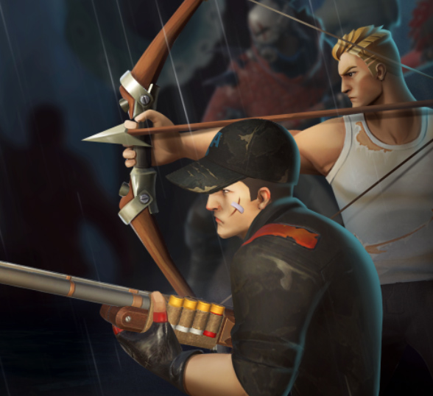
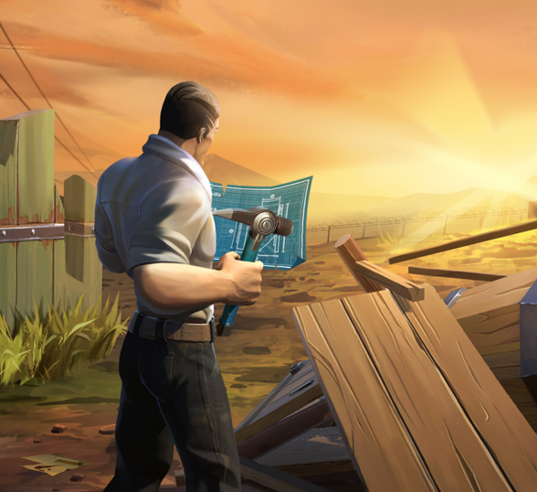
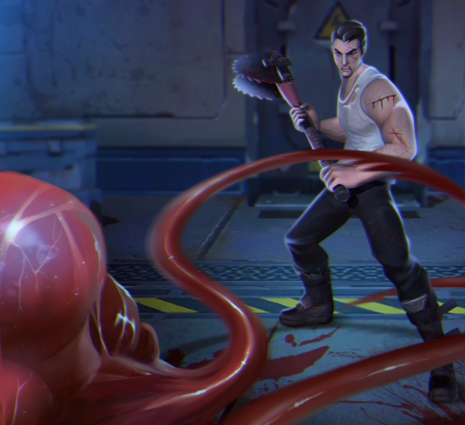
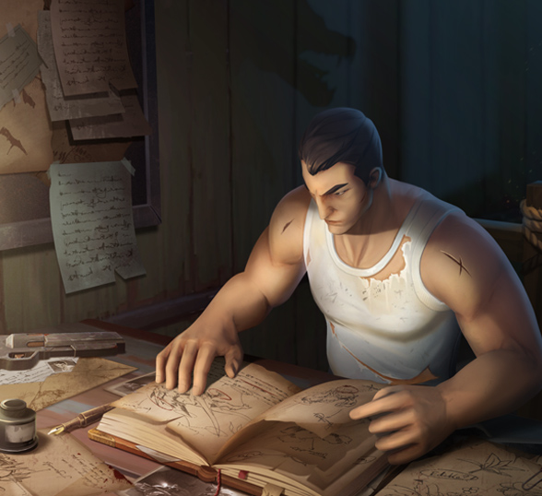
PRODUCT DESCRIPTION
A new experience of survival multiplayer game. Collection of survival, collection, development, sandbox construction, mounts, pets, adventure battles, multiplayer camps on the same screen, etc.

Slide 16






GAME FRAMEWORK
SURVIVOR FACTOR
INSTANCE BATTLE
Hunger/thirst/weather
day/night/disease/cleansing
Rich and interesting instances for single/multiplayer/camp etc
CHARACTER GROWTH
Multiplayer interaction
Game
System
Level/equipment/class/Talent
Team building/ field PK
BASE DEVELOPMENT
COMMERCIALIZE
Ride/base construction
Mature advertising monetization model + in-game purchase

Slide 17
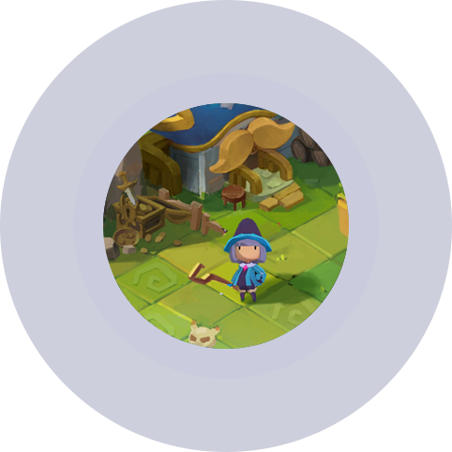
PRODUCT NAME: Story of Cloud Town
Game type: Casual development multiplayer farm game
Scope of sale: Around the world.
Platform: Android/IOS

Slide 18
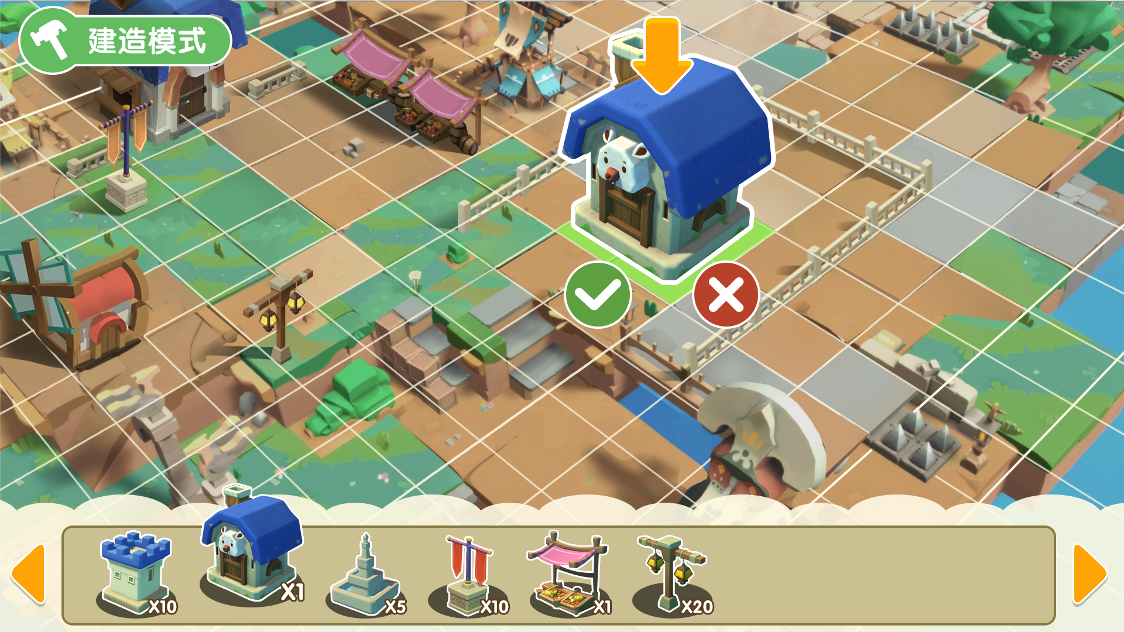
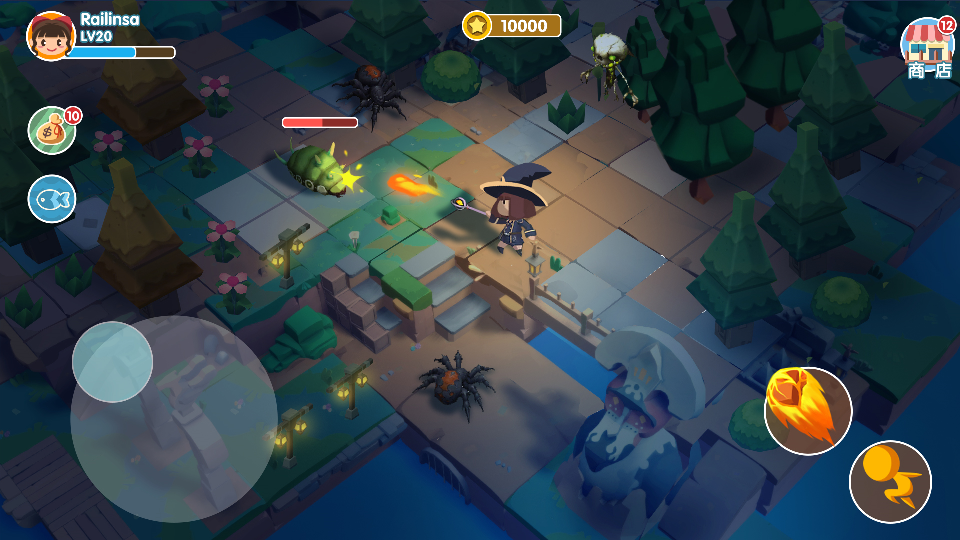
PRODUCT DESCRIPTION
A multiplayer farm Casual development game, aimed at casual users, focusing on multiplayer construction, development, socialization, DIY and so on.
Highly free construction mode, easy to create your favorite town style
Collect more resources and unlock more building decorations
Strategically lay out your town and resist the invasion of alien monsters or enemies
Various field scenes, providing more space for exploration
Unlock more skills of characters and challenge more bosses
More instances for single player/multiplayer/camp, various gameplay

Slide 19
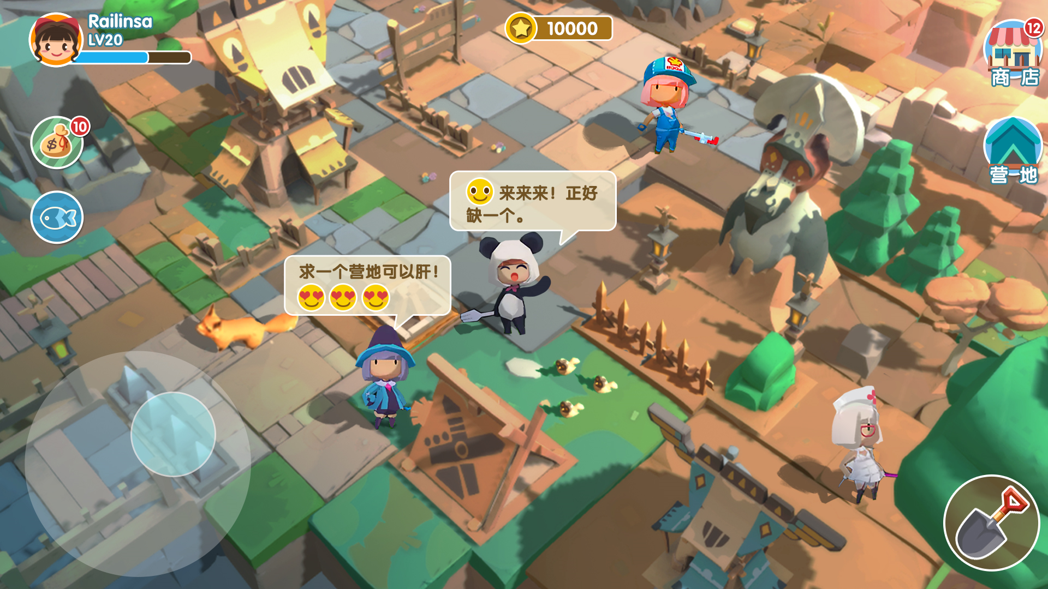
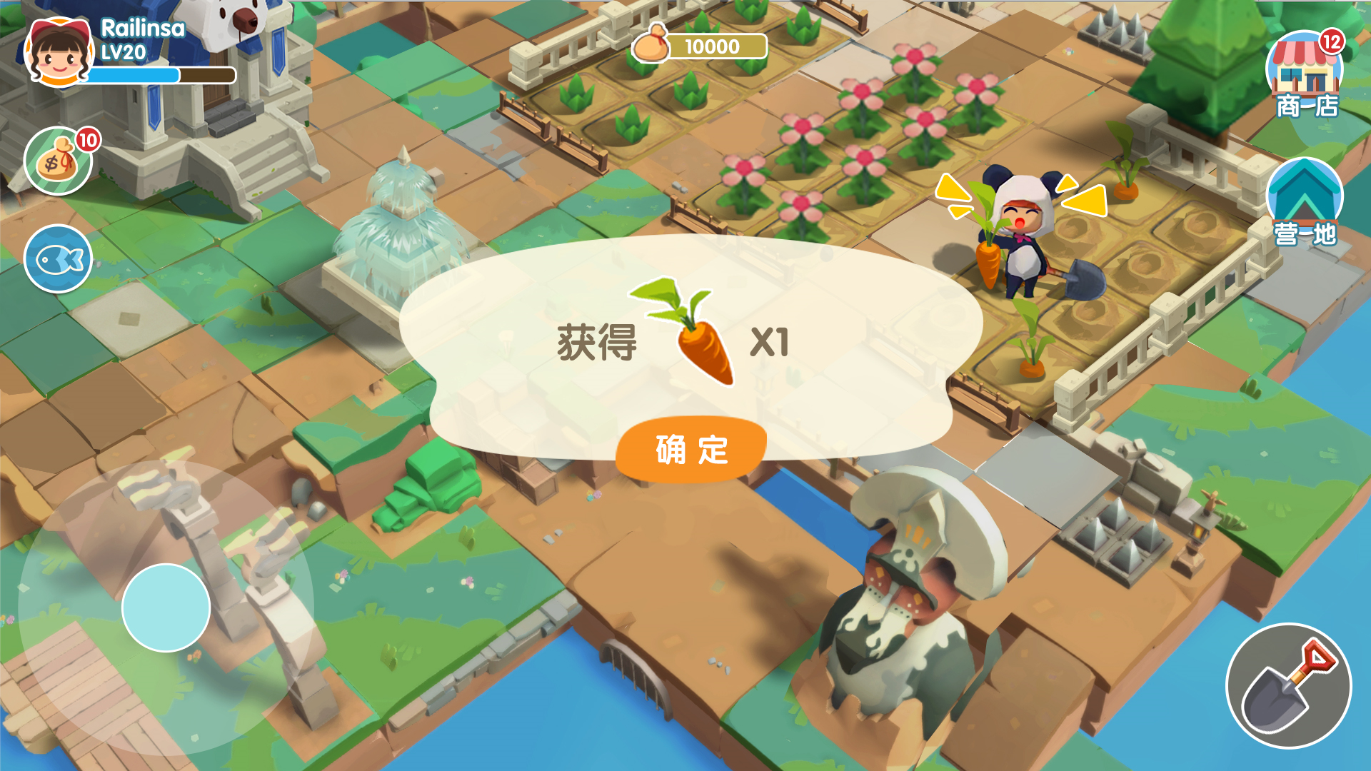
Multiplayer players form a camp to build and survive together
Build buildings together and resist invasion together
Some equipment requires multiple people to participate in the construction
Players in the camp can participate in the camp instance together
Use you fragmented time to grow a variety of crops
Items grown and harvested can be traded
Complete the Planting Order quest to unlock more items

Slide 20
THANK YOU

